Slide 1
DNPT General Body Meeting
November 7th, 2021

Slide 2
Outline
(Re)Introduction
DNPT Trivia
Website Updates
Membership Scholarship
2022 Mission Trip
Questions??

Slide 3
What is the average life expectancy in Nigeria?
54.69 years
78.79 years
66.60 years
85.25 years

Slide 4
What is the average life expectancy in Nigeria?
54.69 years
78.79 years
66.60 years
85.25 years

Slide 5
What is the ratio of healthcare providers to population in Nigeria?
11.5 per 1,000
7.27 per 1,000
5.34 per 1,000
1.95 per 1,000
0 per 1,000

Slide 6
What is the ratio of healthcare providers to population in Nigeria?
11.5 per 1,000
7.27 per 1,000
5.34 per 1,000
1.95 per 1,000
0 per 1,000

Slide 7
What is the leading cause of death in Nigeria?
Lower respiratory infections
Malaria
Ischemic heart disease
HIV/AIDS

Slide 8
What is the leading cause of death in Nigeria?
Lower respiratory infections
Malaria
Ischemic heart disease
HIV/AIDS

Slide 9
What does ANPA stand for?
American Neuropsychiatric Association
Alternative Natural Philosophy Association
Association of Nigerian Physicians in the Americas
American Nigerian Physicians Association

Slide 10
What does ANPA stand for?
American Neuropsychiatric Association
Alternative Natural Philosophy Association
Association of Nigerian Physicians in the Americas
American Nigerian Physicians Association

Slide 11
DNPT Distinguished Nigerian Physicians of Tomorrow
Social Network of Nigerian medical students
Mentorship opportunities within ANPA chapters
Creating a platform to reverse Brain-drain
Providing avenues to volunteer & impact change
Executive Board
President – Alex Adetunji
President Elect – Simisola Odunsayo
Caribbean Representative – Audrey Ekhaguere
Secretary – Temisan Blagogee
Treasurer – Sarah Akanbi
Digital Marketing Coordinator – Peace Odiase
Pre-Med Liaison – Ademide Young

Slide 12
Website
www.dnpt.org
We are now live!!!
Latest organizational updates
Networking Events Calendar, Student Blogs, etc.
Projects & Initiatives
Student Spotlight → Oghenerukeme Asagba
Merchandise
Instagram → @DNPTNaija
Facebook → @DNPTNigeria
Gmail → DNPT.Membership@gmail.com

Slide 13
Membership Scholarship
Giving away free money
One $500 Scholarship to DNPT Member
Eligibility
Due paying member
($30) Graduate Students ($25) Undergraduate Students
Graduate or Undergraduate student
Submit a 350-500 word essay or a 3-5 minute video detailing:
Future Health Goals for Nigeria?
Healthcare Issue Important to you?
Due by December 31, 2021
DNPT.membership@gmail.com → DNPT Scholarship Submission

Slide 14
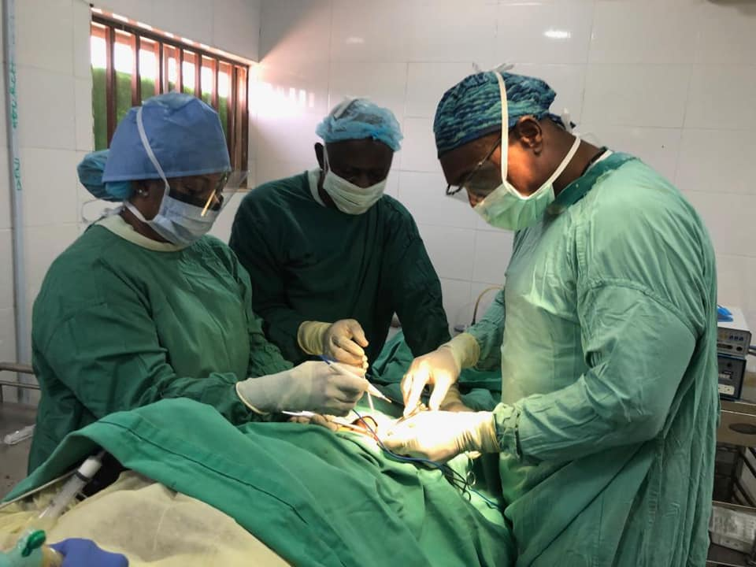
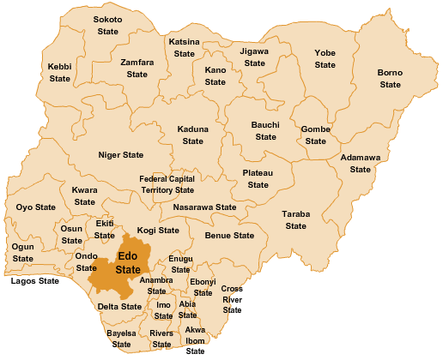
2022 Mission Trip
Edo State, Nigeria → April 25th – 29th, 2022.
Medical, Surgical, Dental, Pharmacy, Ophthalmology Services
Edo State General Hospital
Call for Committed Volunteers (November 30, 2021)
DNPT.membership@gmail.com
All volunteers must be fully vaccinated against Covid-19
Accommodations & Boarding will be provided by ANPA
Virtual mtgs every 2 weeks after finalizing volunteer list
Flights Directly into Benin City

Slide 15
Chapter Interaction
DNPT Campus Representatives
Group engagement & ANPA engagement
July 2022 Convention – Charlotte, NC
Monthly Grand Rounds Initiative
Membership Dues – ($30/$25)
Zelle – sakanbi1@gmail.com (224-305-6153)
Subject Line – DNPT Membership Dues
West Coast
→ Southern California, North Texas/DFW, Houston.
East Coast
→ Carolinas, Chicago/Northwest Indiana, Georgia, Florida, Nashville/Middle TN, DMV Area.

Slide 16
Questions??
Let’s help to continue to change the narrative!

