Slide 1
DNPT General Body Meeting
February 20, 2022

Slide 2
Today’s Agenda
Announcements
“Sickle Cell Disease in the Diaspora”
Discussion
Website Updates → Peace Odiase
Social Media Updates → Ademide Young

Slide 3
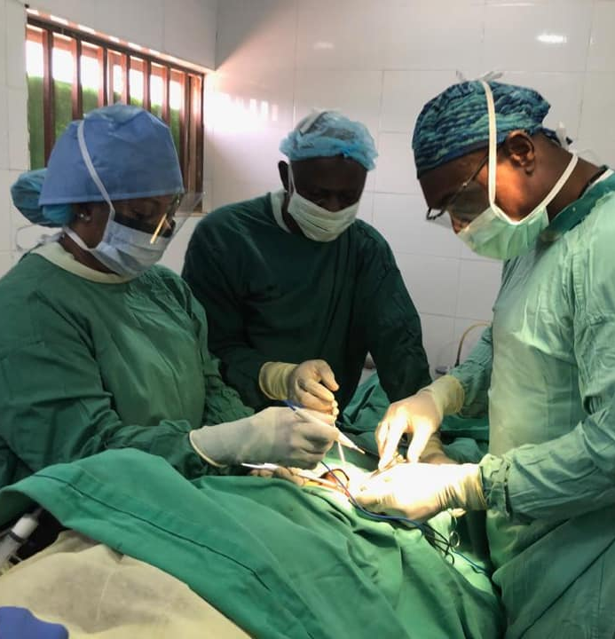
Announcements
Nigeria Mission Trip
Edo State General Hospital (April 25-29th, 2022)
Medical, Dental, Pharmaceutical, Ophthalmology Services
Accommodations & Boarding provided by ANPA
Grand Rounds
February 25th → Osteoarthritis and Orthopedic Management (9AM EST/3PM NIG)
Scholarship Opportunities
Membership Scholarship ($500)
Submit 500 word or 5-minute video
Current Healthcare Issue and Proposed Health Goals for Nigeria
Olusegun Salako Travel Fellowship Award ($1000)
Submit Abstracts for the Annual Scientific Conference

Slide 4
Announcements
Merch Loading!
DNPT Campus Representatives
Dnpt.membership@gmail.com
28th Annual ANPA-DNPT Convention
Charlotte, NC (June 22-26, 2022)
Conference Events
Lectures and Social Mixer w/ ANPA Physicians
Resident Panel Discussions
Residency Application Workshops
Networking/Gala Event

Slide 5
Sickle Cell in the Diaspora

Slide 6
Sickle Cell Disease (SCD)
Most common genetic disorder
AR disorder caused by mutation in the hemoglobin beta (HBB) subunit gene leading to RBC Sickling (HbS).
Sickle Cell Trait
All types of SCD leads to Reduced Lifespan, Progressive Organ Damage and Pain
Median age of death 45-48 yo

Slide 7
HbS Distribution and SCD Incidence
39% SCD were ≤ 18 years old
Median Age
High Income Countries: 29 years (IQR, 19-37)
Low Income Countries: 17 years (IQR, 11-26)

Slide 8
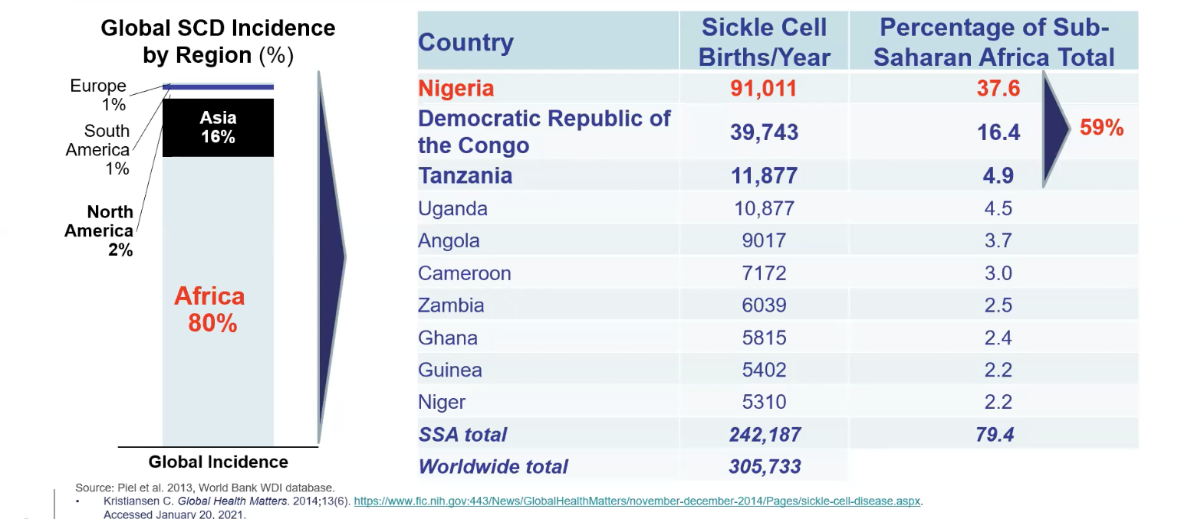
Disease Burden
Top 3 Countries = 59% of Sub-Saharan African Total
Large margin between Nigeria and Other African countries

Slide 9
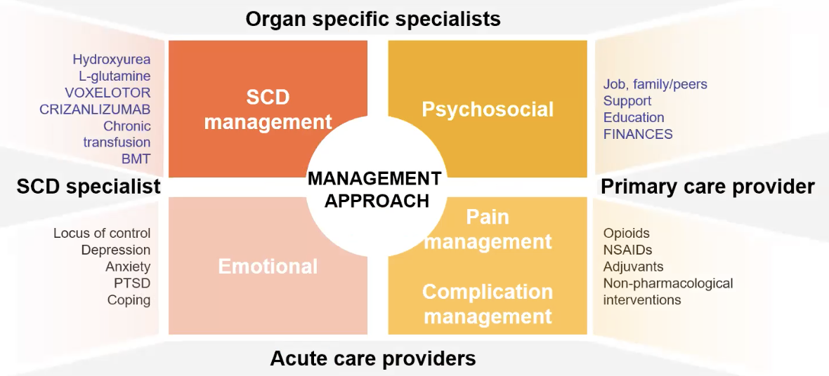
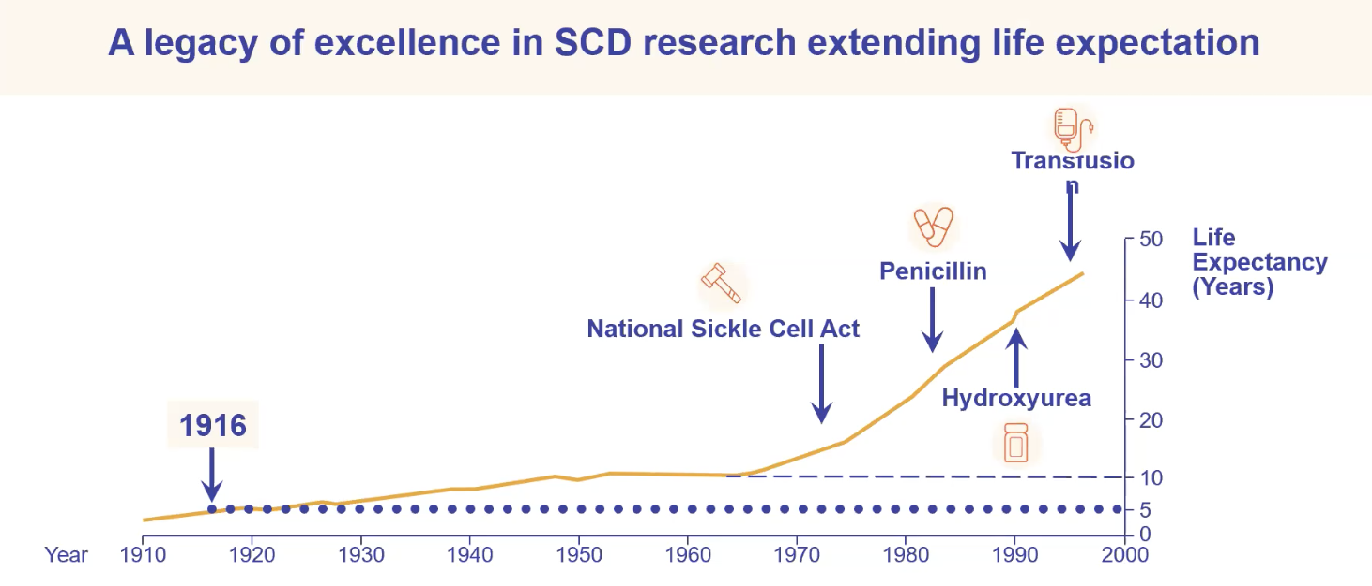
SCD Management
Prescribed treatment generally lower in Ghana/Nigeria

Slide 10
Newborn Screening
American Society of Hematology launched CONSA to diagnose SCD at birth
Consortium on Newborn Screening of Africa (CONSA)
Nigeria, Ghana, Kenya, Liberia, Tanzania, Uganda, Zambia
50-90% of children born with SCD in Africa die before the age of 5
Infant mortality due to SCD ranges from 5% to 19% of overall mortality in children aged ≤ 5 years
Despite the huge SCD burden and advantages associated with screening, Benin and Ghana are the only countries with comprehensive newborn screening programs
Program in Benin targets only mothers with the Sickle Cell Trait
Other nations are exploring national newborn screening programs
Even when screening is available, few patients get the opportunity to benefit
In low-resource countries, access to newborn screening for SCD is limited because of economic constraints

Slide 11
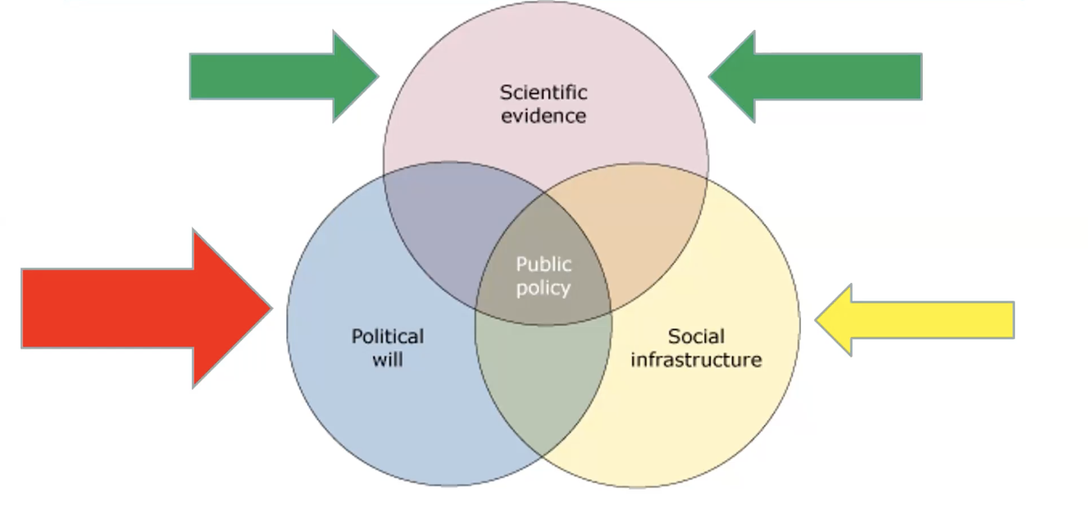
Sickle Cell Disease (SCD)
What is the role of collaboration of public and private partnerships in optimizing outcomes for SCD in Low-Middle Income Countries?

Slide 12
Quick Updates
Website (Dnpt.org)
Media Platforms (IG/Facebook)
Membership Dues
Professional Students ($30) Undergraduates ($25)
Zelle – sakanbi1@gmail.com (224-305-6153)
Subject Line – ‘DNPT Membership Dues’
Dnpt.membership@gmail.com

Slide 13
Thanks for Joining!
Let’s help to continue to change the narrative.

